Slide 1
Building Poker Bot with Reinforcement Learning
László Barak, Mónika Farsang, Ádám Szukics
BMEVITMAV45
Deep Learning in Practice with Python and LUA
2020/21/1

Slide 2
CONTENTS
Introduction
Literature review
Methodology
Results and Discussion
Demo
Conclusion

Slide 3
INTRODUCTION
01
Perfect vs. Imperfect-information games
Notes:
Bevezető
Teljesinformációs vs nem teljesinformációs játék

Slide 4
GAME THEORY
PERFECT INFORMATION GAME
IMPERFECT INFORMATION GAME
Easier to solve
Perfectly informed of all the events
Initialization event is known (in card games)
e.g. Chess, Go
Hidden information (opponent’s card, bluff)
Players need to balance all possible outcomes when making a decision
e.g. Poker
Notes:
Játékelmélet
Teljesinformációs játék:
Könnyebb
Minden esemény tudott
Kezdeti esemény is tudott (pl az ellenfél lapjai)
Nem teljesinformációs játék:
Rejtett információ (pl a másik játékos kártyái, blöffölés)
A játékosoknak figyelembe kell venniük a lehetséges kimeneteleket, amikor döntenek

Slide 5
LITERATURE REVIEW
02
Previous solutions

Slide 6
TIMELINE OF POKER AI SOLUTIONS
2008
Pluribus
2015
2016
2017
2018
2019
Polaris
Cepheus
NFSP
DeepStack
Liberatus
Notes:
2008:
- Polaris contains a number of other fixed strategies, and chooses between these strategies during a match.
- Polaris plays only heads-up (two player) Limit Texas hold'em.
2015:
- Cepheus (the name of the supercomputer)
68 days with CPUs, using a special version of Counterfactual Regret Minimization (CFR). Cepheus heavily outperformed Polaris.
2016:
NFSP (Neural Fictitious Self-Play) is the first deep reinforcement learning method known to converge to approximate Nash equilibria in self-play.
2017:
DeepStack achieved expert-level artificial intelligence in Heads-Up No-Limit Poker.
It became the first poker AI that managed to beat professional poker players in Heads-Up No-Limit Texas Hold’em.
2018:
- Libratus was created without any domain knowledge and also greatly reduced the required training time.
It defeated four top human specialist professionals in a 120,000-hand competition in Heads-Up No-Limit Texas Hold’em.
2019:
Pluribus crushed multiple humans simultaneously
It was tested in six-player No-Limit Texas Hold’em poker, the most commonly played poker format in the world.

Slide 7
METHODOLOGY
03
Environment and Algorithm

Slide 8
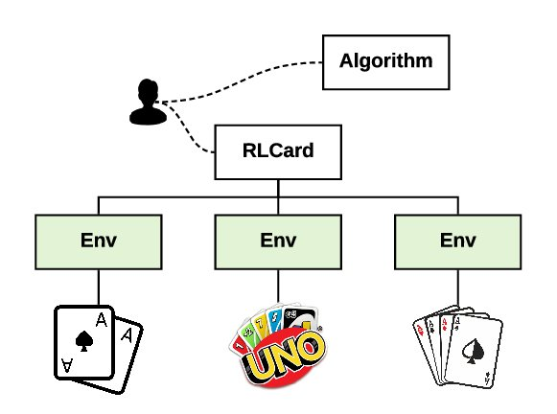
ENVIRONMENT
RLCard toolkit
For reinforcement learning research
Limit Hold’em and Leduc Hold’em environment
Image:
https://arxiv.org/pdf/1910.04376.pdf
Notes:
Az RLCard toolkit könnyen használható…

Slide 9
LEDUC HOLD’EM AND LIMIT HOLD’EM
6 cards (two pairs of K, Q, J )
2 rounds
2 raise action in first round
4 raise action in second round
52 cards
4 rounds
4 raise action in each round

Slide 10
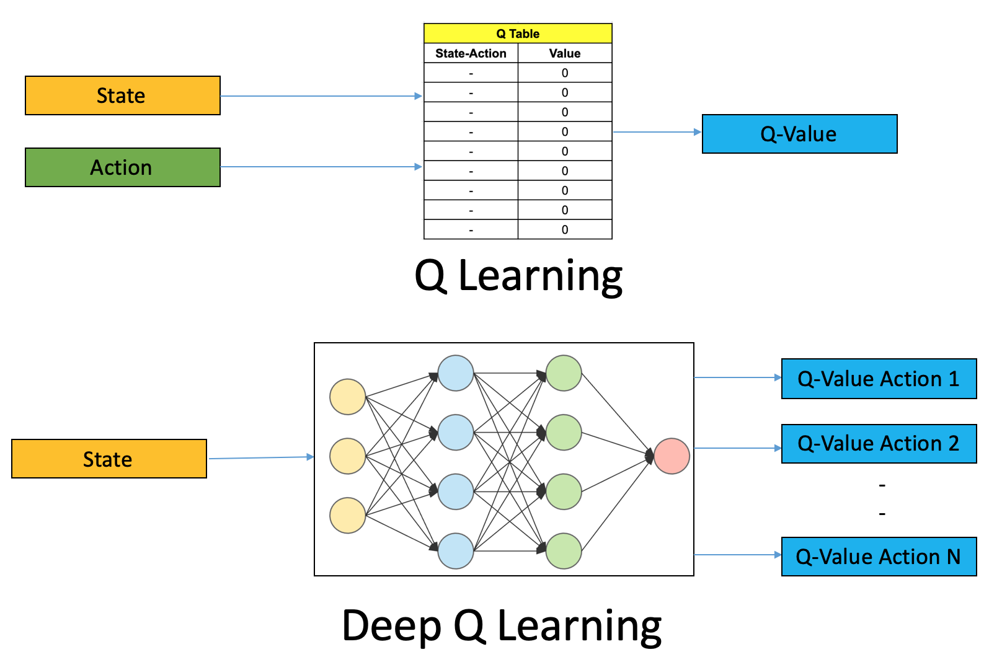
ALGORITHM
Deep Q Learning
Implemented in PyTorch
Estimate a Q-value given the current state
Replay buffer to store past experiences
Image:
https://medium.com/analytics-vidhya/a-hands-on-introduction-to-deep-q-learning-using-openai-gym-in-python-b15d7d8597d

Slide 11
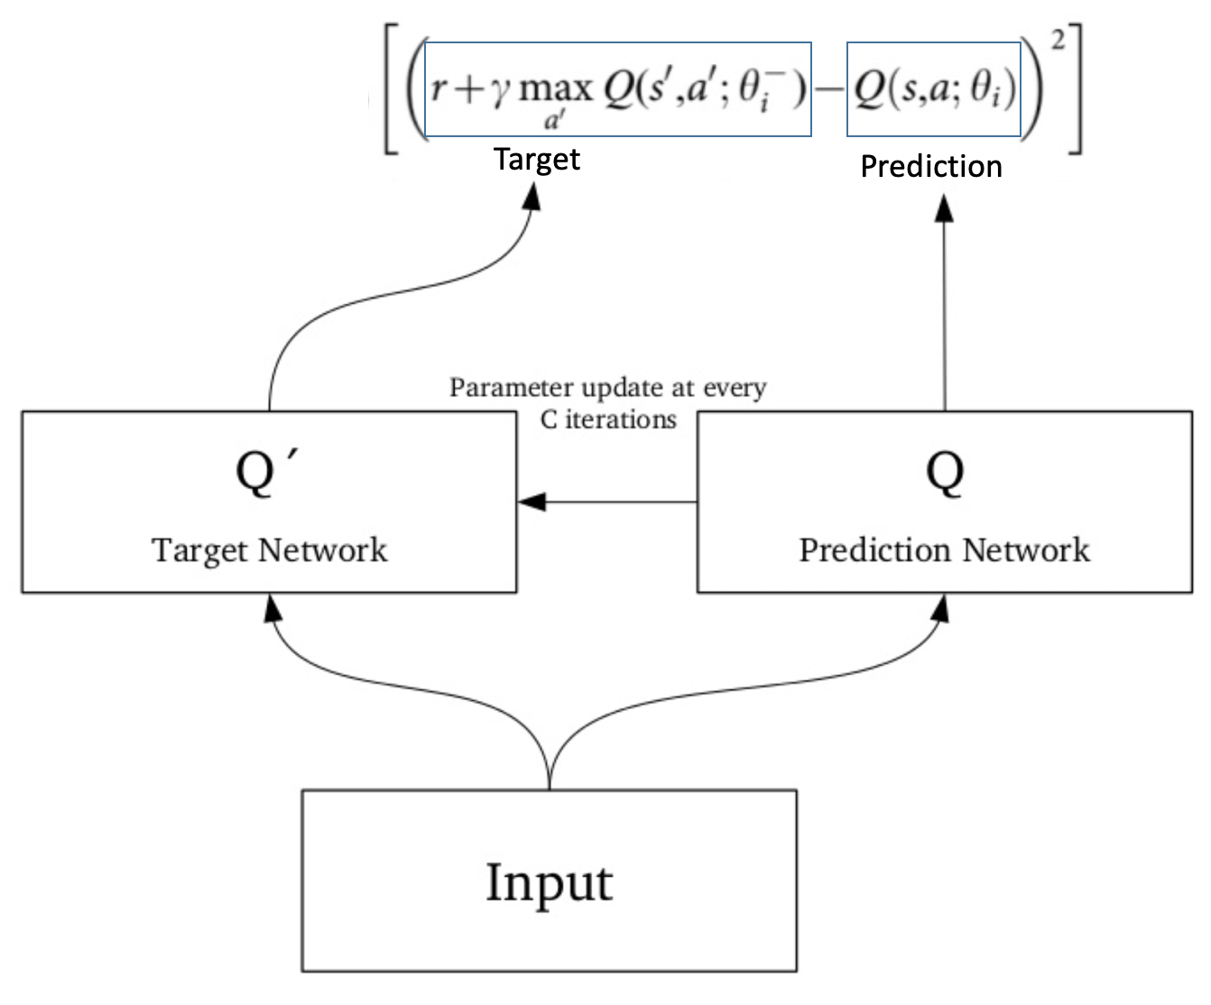
ALGORITHM
Deep Q Learning
Two networks: Target and Prediction/Policy network
Best action from the Policy network
Image:
https://medium.com/analytics-vidhya/a-hands-on-introduction-to-deep-q-learning-using-openai-gym-in-python-b15d7d8597d

Slide 12
… AND THE EXTRA COMPONENT
Idea: Creating an aggressive playing strategy with more raising actions
 | MODIFICATION
DQN-CAR | Instead of call choose raise (if valid)
DQN-CHR | Instead of check choose raise (if valid)
DQN-FR | Instead of fold choose raise (if valid)

Slide 13
HYPERPARAMETER TUNING
Layers: The size of the networks
Learning rate: Learning rate used by optimization
Batch size: How many samples from the replay memory
Replay memory size: How many experiences can the memory store
Discount factor: How important are the immediate rewards, close to 1 means that the results have same weight (0-1)
In total: 215 different settings

Slide 14
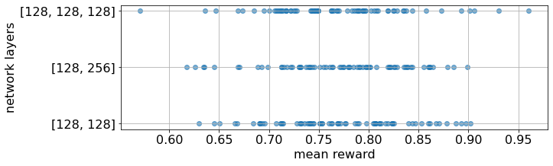
NETWORK LAYERS
Notes:
3 réteg: 128, 128, 128 neuronnal

Slide 15
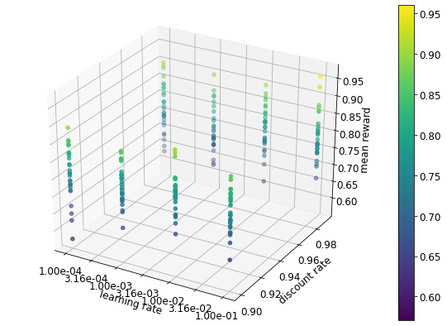
LEARNING AND DISCOUNT RATE
Notes:
Learning rate: 0.1
Discount factor: 0.99

Slide 16
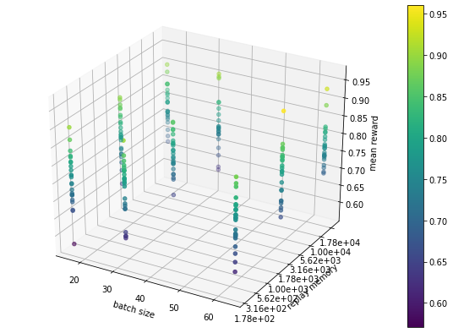
BATCH SIZE AND REPLAY MEMORY SIZE
Notes:
Replay memory: 2000
Batch size: 64

Slide 17
RESULTS
04
Peformance of the algorithm,
Discussion

Slide 18
LEDUC HOLD’EM
 | MEAN REWARD | REWARD VARIANCE
CFR | 0.734 | 0.300
DQN | 0.960 | 0.265
DQN-CAR | 1.261 | 0.352
DQN-CHR | 0.682 | 0.285
DQN-FR | 0.723 | 0.202
Notes:
Next, we investigate how the proposed agents affect the results in both environments. We trained them 1000 episodes long and they were evaluated with 100 games in each tenth episode. The reward is calculated from the last 10 evaluations. Table II.and Table III. display the average rewards and their variance in Leduc Hold’em and Limit Hold’em.
The most important finding is that the different versions of the traditional DQN agent have an effect on the performance. Moreover, if the agent prefers raising to calling, the performance is significantly better.
In the case of the Leduc Hold’em environment, the DQN-CAR algorithm exceeds the baseline DQN by more than 30% with respect to the achieved average reward. Furthermore, it also performs better than the CFR agent. Meanwhile, the other two methods underperform the classical DQN and CFR as well.

Slide 19
LIMIT HOLD’EM
 | MEAN REWARD | REWARD VARIANCE
DQN | 2.057 | 0.258
DQN-CAR | 2.870 | 0.465
DQN-CHR | 1.806 | 0.433
DQN-FR | 1.713 | 0.276
Notes:
Similar results come from the Limit Hold’em environment, where the DQN-CAR outperforms the DQN algorithm by almost 40% improvement. In this game, the CFR agent learns far slower, because it requires full traversals of the game tree [14], which is infeasible in a larger game. To overcome this situation, abstraction is typically applied before running CFR, where determining a good abstraction can be a huge challenge [15]. We found this to be a part that falls outside the scope of this paper. For this reason, there is no comparison with the CFR agent in the Limit Hold’em environment.

Slide 20
LEDUC HOLD’EM: AGAINST PRETRAINED AGENT
 | MEAN REWARD | REWARD VARIANCE
CFR | 0.484 | 0.288
DQN | -0.049 | 0.350
DQN-CAR | 0.023 | 0.350
DQN-CHR | 0.093 | 0.353
DQN-FR | -0.001 | 0.367
Notes:
These results with the proposed DQN-CAR algorithm against a random agent shows great performance in both environments. However, it is important to note its limitations. While the aggressive strategy works well against a random agent, the opposite can happen against a stronger opponent. As suggested from [9], the problem of the DQN policy is that it may be highly exploitable since it is easy to find its weaknesses. Indeed, if we train the algorithms against a pre-trained NFSP agent, their performance drops drastically.

Slide 21
LEDUC HOLD’EM: WHO HAS MORE CHIPS
 | WIN PERCENTAGE
CFR | 75.88
DQN | 71.2
DQN-CAR | 76.99
DQN-CHR | 70.86
DQN-FR | 70.98
Notes:
Long-term planning poker bots have not been in the main focus of research. To handle this problem, we created a simple CFR agent by editing its code in the RLCard library. For computational reasons, our implementation only deals with 2 rounds of play, and it is specialized in a curious way: its main goal is to have more chips at the end of the round than the opponent has. As CFR learns by traversing the tree and correcting its policy by the calculated regrets, moving beyond two rounds resulted in a really slow learning speed.

Slide 22
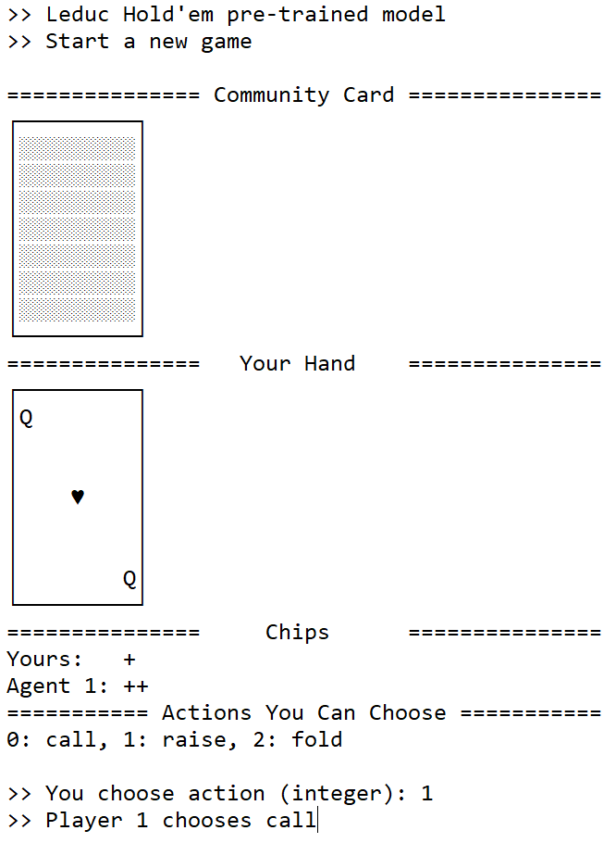


POKER BOT WITH DQN-CAR
DOCKER
GOOGLE COLAB NOTEBOOK
Images:
https://medium.com/@karthi.net/docker-tutorial-build-docker-image-for-your-angular-6-application-fcd627629e61
https://medium.com/datasciencebuddy/colab-the-coolest-gift-to-data-scientists-from-google-817487acb8de

Slide 23
DEMO
05
Playing against our Poker AI

Slide 24
CONCLUSION
06
Our goal, Limitations and Future plans

Slide 25
01
02
03
OUR GOAL
LIMITATION
FUTURE PLANS
We successfully created our own poker AI.
We recommend our poker bot for beginner and intermediate level players especially.
Our poker bot has lower performance against stronger opponents.
Creating an advanced level poker AI
Builing a poker bot in any level in No-Limit Texas Hold’em

Slide 26
THANK YOU for your attention!

